Slide 1
University Centre for Support and Personal Development

Slide 2
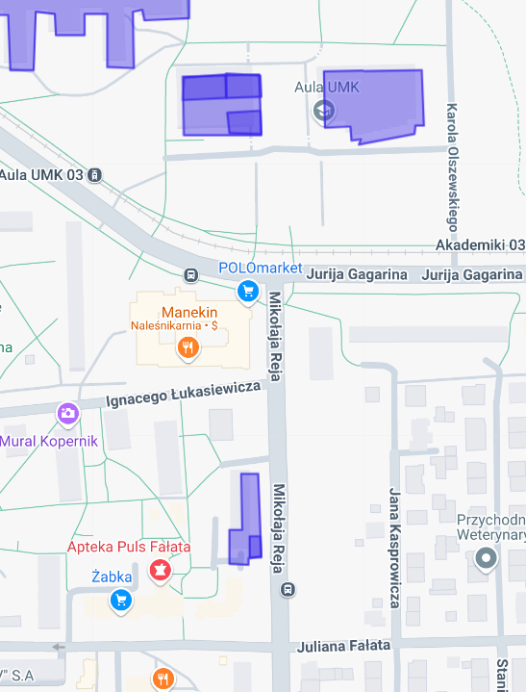
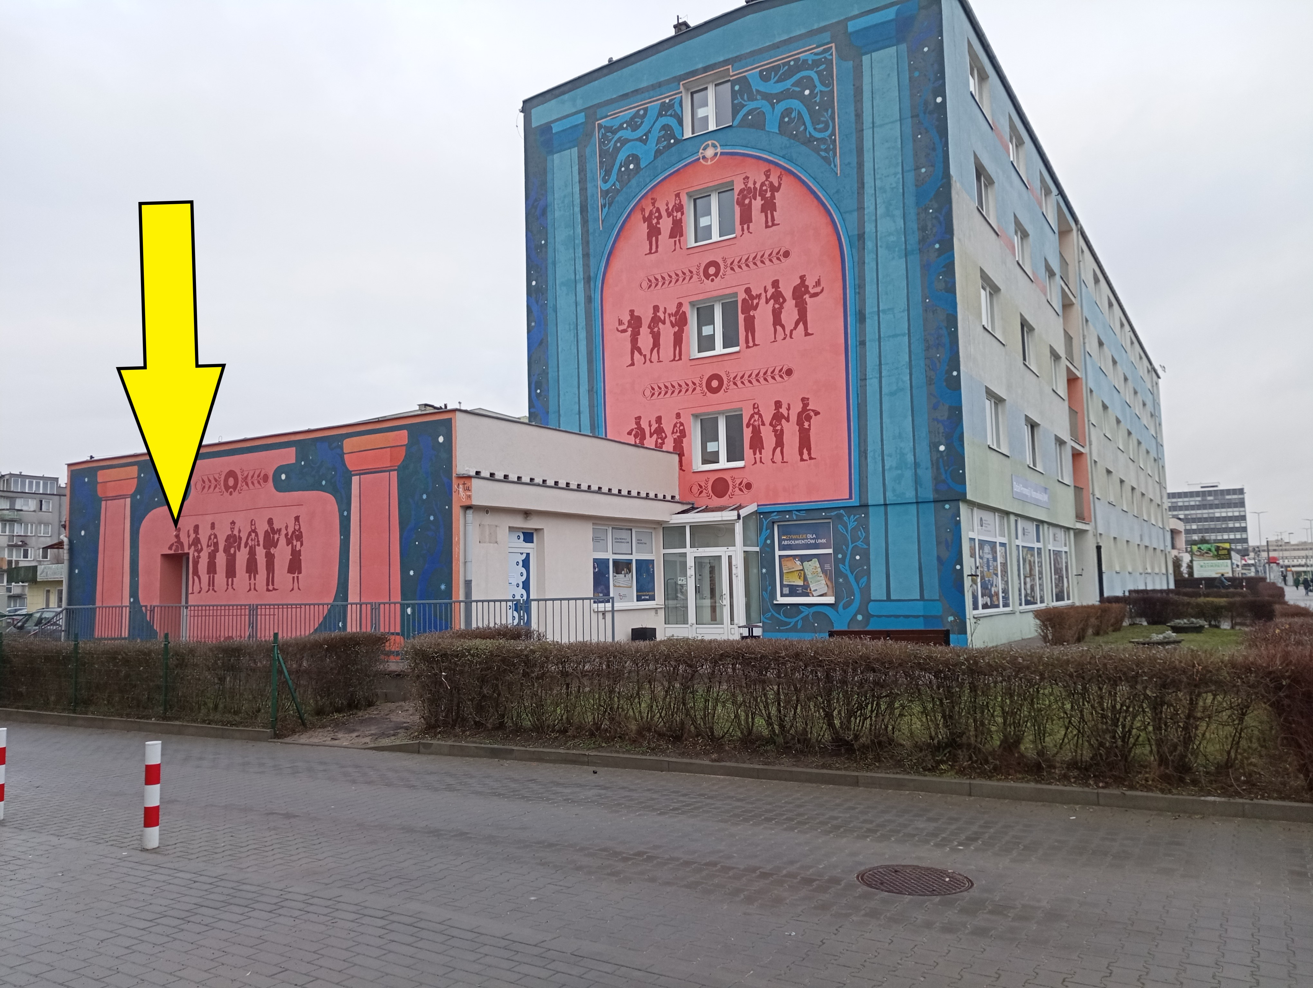
University Centre for Support and Personal Development
Location of the Centre – Toruń, ul. Reja 25
Where to find us:
NCU Rector’s Office
NCU Auditorium
Student House no. 12
Location of the Centre

Slide 3
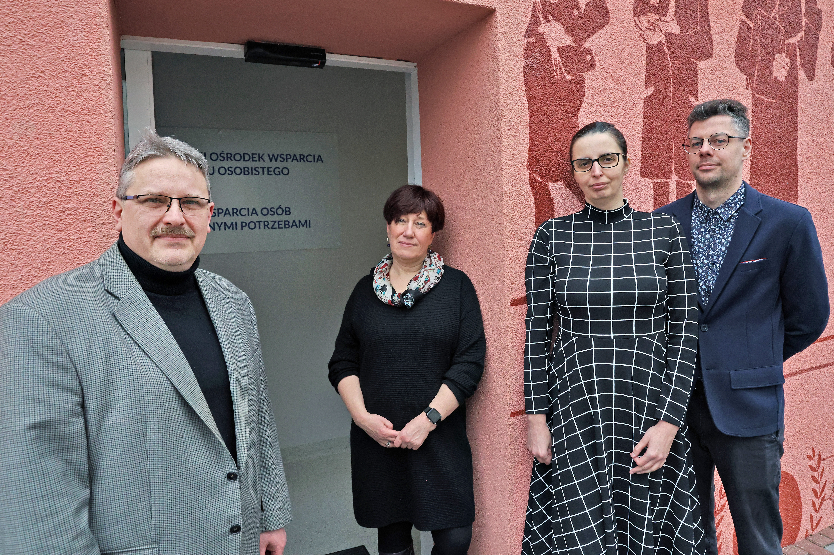
University Centre for Support and Personal Development
Centre Staff
Personal Development Unit:
Director – dr hab. Hanna Solarczyk-Szwec, NCU Professor
Support Unit for People with Special Needs:
Deputy Director – Sławomir Rylich
Katarzyna Makowska
Mikołaj Piekut

Slide 4
University Centre for Support and Personal Development
Supporting You Through Crises
Psychological consultations – to arrange an appointment, send a text message to one of our psychologists:
dr Magdalena Cyrklaff-Gorczyca – phone no.: 502 695 564
mgr Barbara Lorek – phone no.: 662 030 772
Psychiatric consultations – to schedule a visit, send a text message to a psychologist. If deemed necessary, you will be referred to a psychiatrist. (REMEDIS PRO Centre for Psychotherapy and Personal Development, Toruń, ul. Moniuszki 39)

Slide 5
University Centre for Support and Personal Development
Caring for Your Well-Being
Health prescription: issued by a psychologist for activities of your choice at the University Sports Centre.
Get moving! at your desk – relaxation and exercises with a USC trainer (online, Thursday at 2:30 PM).
Look for relaxation zones (University Library and Copernican Integration Centre) and quiet rooms in your faculty building or nearby.
Stay updated with the programmes available at the Copernican Integration Centre.

Slide 6
University Centre for Support and Personal Development
Helping You Overcome Learning Difficulties
Struggling to motivate yourself to write your doctoral thesis?
Want to manage your time more effectively?
Need assistance with the dean’s office or library?
Looking for individual support during your studies?
Contact Us!

Slide 7
University Centre for Support and Personal Development
Supporting Your Individual Needs
Educational assistants
Academic support
Adaptation of courses to your needs
Individual language lessons
Adapted physical education classes and sports for people with disabilities
Equipment and assistive software rental
Transportation assistance
Help with administrative matters related to your studies
Support with communicating with your teachers

Slide 8
University Centre for Support and Personal Development
"Don’t Disappear" Mental Health
Campaign 2024/2025
Schedule an in-person meeting with a staff member from the Centre
Complete a mental health self-assessment
Receive (self-)help tips
Find out when we’ll be visiting your faculty

Slide 9
University Centre for Support and Personal Development
Discover the Centre’s Complete Range of Services
University Centre for Support and Personal Development
Phone no.: 56 611 49 33
e-mail: ośrodek_wsparcia@umk.pl
WWW: wsparcie.umk.pl
Support Unit for People with Special Needs
Phone no.: 56 611 49 83
e-mail: bon@umk.pl
WWW: bon.umk.pl

